Slide 1
PubSubHubbub
Wikidata.lib
Sebastian Brückner, Alexander Lehmann
13.03.2014

Slide 2
PubSubHubbub
The Protocol
Implementation
Tests
Customer Reports
Protocol Issues
Composer
Deployment
Agenda

Slide 3
PubSubHubbub
PubSubHubbub (PuSH) is a protocol that enables resources to push changes to subscribers.

Slide 4
Publishing a Change
Publisher client sends an HTTP POST request to the hub
Request contains the following data:
hub.mode=publish& hub.url=http://a.resource.url/& hub.url=http://another.resource.url/ …

Slide 5
Identifying Resources
Every web page can be a resource
Resources need special HTTP headers for identification:
Link: <http://this.is.a.hub/>; rel="hub" Link: <http://this.is.the.resource/>; rel="self"

Slide 6
Pushing to Subscribers
Hub sends an HTTP POST request to each subscriber
Request contains special HTTP headers for identification of hub and resource:
Link: <http://this.is.a.hub/>; rel="hub" Link: <http://this.is.the.resource/>; rel="self" X-Hub-Signature: sha1=728b02d392a2bddb7d002f82012a9a8bab4feb1a
New contents of resource are body of the request
Notes:
Hub-Signature: a secret the subscriber sent to the hub when registering for a resource

Slide 7

Implementation
Tasks of our MediaWiki extension:
Add Link HTTP headers to each article and Wikibase item
Send a publish event to the hub whenever anything changes
Currently, we fully support MediaWiki articles and WikiData objects
In the future, we will also support:
Creation of new articles / WikiData objects
Deletion of articles / WikiData objects

Slide 8
Adding Link Headers
MediaWiki hook: ArticlePageDataAfter and RawPageViewBeforeOutput
Detect type of page
MediaWiki article:
Generate “raw” article URL
WikiData entity:
Generate “Special:EntityData/Q1234”-like URL
Add correct Link headers to the HTTP response
Content pushed to subscribers is either WikiMarkup (for articles) or JSON (for WikiData objects)
Notes:
Explain “raw” URL

Slide 9
Detecting Changes
MediaWiki hook: PageContentSaveComplete
Check if the contents have actually changed
Add a new job to the JobQueue
When the job is executed: Send a publish event to the hub
Notes:
Actually changed: i.e. pressing on save withouth any change
Explain JobQueue

Slide 10

Demo

Slide 11
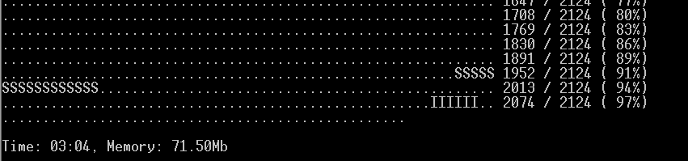

Tests
Why do we test?
Works as expected
Do not destroy other parts of the software
Meets design requirements
Notes:
modular

Slide 12
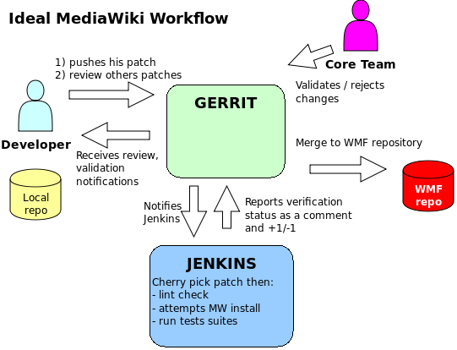
Mediawiki Workflow
http://www.mediawiki.org/wiki/File:GitWorkflow.svg

Slide 13

PHPUnit
﻿Testing framework for PHP
﻿Instance of the xUnit architecture
Conventions
The tests for a class “Class” go into a class “ClassTest”
ClassTest inherits from PHPUnit_Framework_TestCase
Each test methods has an assertion methods
Notes:
Gruppen, dependencies, Daten Provider, exceptions

Slide 14
What Do We Test?
onPageContentSaveComplete – creation of the publishing job
Database mockup
/**
* @group Database
*/
class PubSubHubbubTest extends MediaWikiLangTestCase {
..
}
Create a test article with a base revision
$title = Title::newFromText( "text" );
$article = new Article( $title );
$baseRevId = false;

Slide 15
What Do We Test?
Check job table
$row = [ [ 0 ] ];
$this->assertSelect( "job", "count(*)", "", $row );
Generation of the link headers
String comparison
(Publishing of changes)

Slide 16

Customer Reports - DBpedia
Currently use ﻿OAI-PMH
Requirements
Mirroring of all entities
Metadata of changes
Subscriber client
As many output formats as possible
Wiki Markup unnecessary

Slide 17
Protocol Issues
Originally for RSS-Feeds → resource URL
URL for all changes
New URL for all output formats
No metadata
Insert, deletes, changes indistinguishable
Wikipage URL ≠ resource URL
Groups of resources not supported
Performans issues

Slide 18
Possible Solution
Publisher is connected with the export interface of MediaWiki
Subscriber is connected with the import interface of MediaWiki
Only publish changes of all resources and changes of a single resource
Groups support can be implemented by subscribers

Slide 19

Composer
Composer is a PHP dependency management manager
Vision at MediaWiki: Declare required extensions:
{ "require": { "wikibase/wikibase": "*", "bp2013n2/pubsubhubbub": "*", … } }
Run composer install
All declared MediaWiki extensions will be downloaded and installed
But: We‘re not quite there yet.
Notes:
(It works for some extensions)
Anyway: Extensions are supposed to declare dependencies using Composer.

Slide 20
Our composer.json
To comply with WMDE‘s wish to use Composer, we added Composer support:
{ "name": "bp2013n2/pubsubhubbub", "type": "mediawiki-extension", "description": "Allows publishing changes to a PubSubHubbub hub", "keywords": ["pubsubhubbub", "push", "rss", "wikibase", "wikidata"], "homepage": "https://www.mediawiki.org/wiki/Extension:PubSubHubbub", "license": "GPL-2.0+", …
Installing our extension on a MediaWiki ist just 1 line in composer.json!

Slide 21
Deployment
Implement resource that publishes changes to everything (e.g. using RecentChanges API)
Figure out hub deployment options
Either WikiMedia hosts an own hub (reimplement?)
Ask Google if they‘re ok with the load
Finish unit tests and add Jenkins integration
Write Puppet module for the extension
Notes:
Hub is an AppEngine application
Explain Puppet (configuration management tool)

Slide 22

Questions

